Slide 1
Radio Base Stations Sited on Power Line Towers
Urban Metod Peterlin, M.Sc.
Jure Strmec, M.Sc.
Dušan Huč, M.Sc.
Electric Power Plants and Facilities Environmental Effects Department
Milan Vidmar Electric Power Research Institute
Ljubljana, Slovenia
urban.peterlin@eimv.si
Montenegrin Committee CIGRE – 5th Session
Bečići, Montenegro, May 2017

Slide 2
Introduction
Why position radio base stations on power line towers?
To optimize the coverage of the territory with mobile telephone network in rural areas where there are no other tall buildings where antennas could be installed.
Because it is difficult to find suitable sites and obtain permits to build new radio base stations towers.

Slide 3
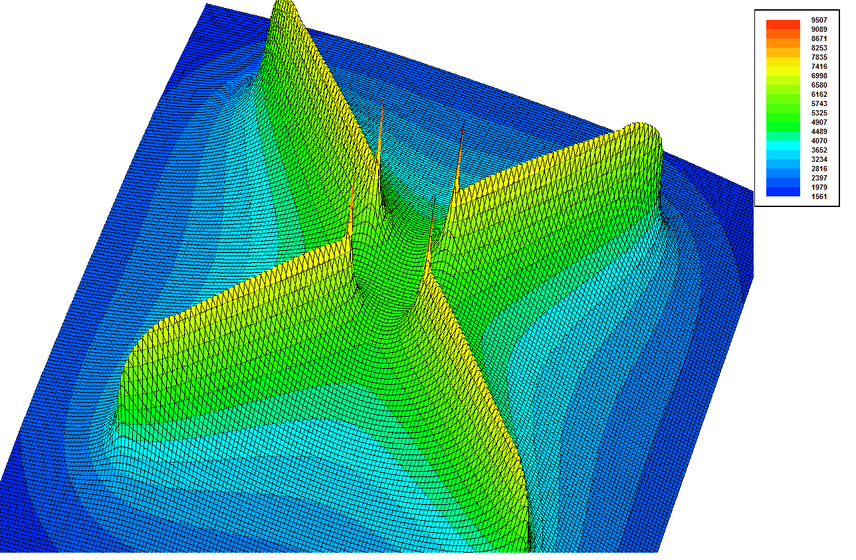
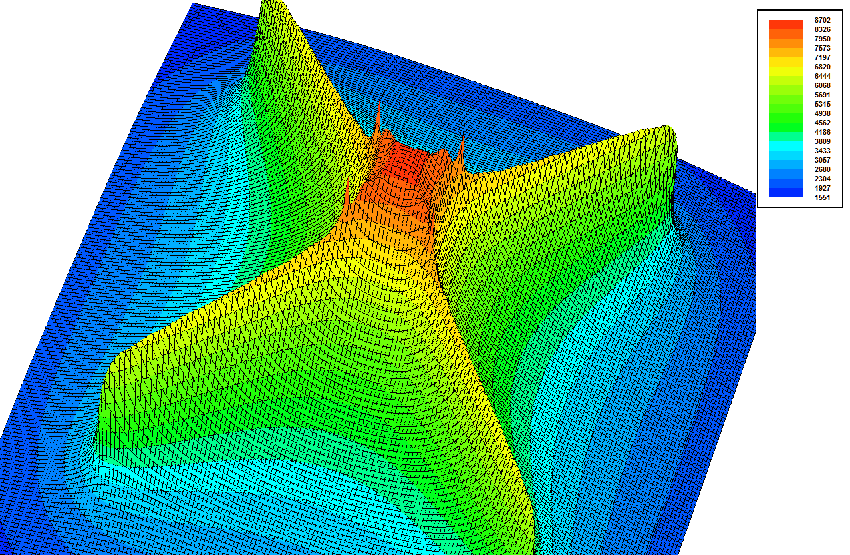
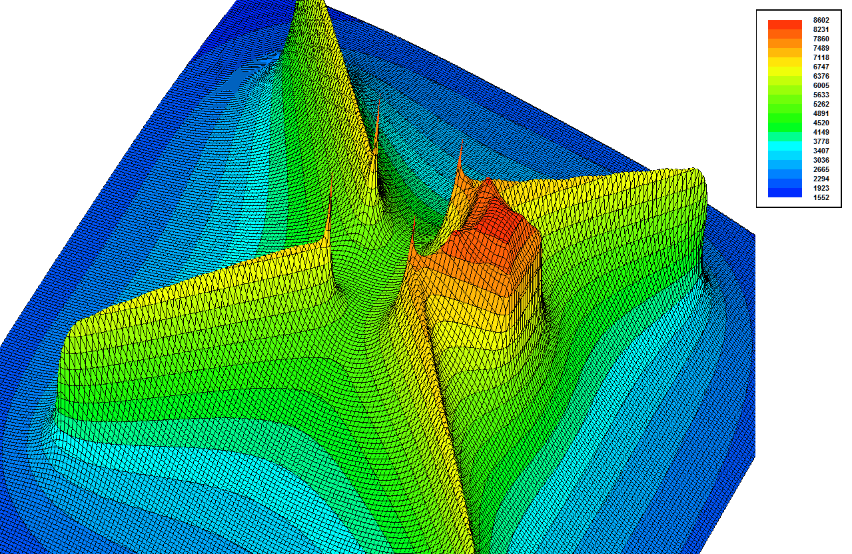
Aspects to which attention should be given (1)
Tower potential rise:
Earth potential rise in case of earth fault on a power line tower
Lightning strike at the tower or transmisssion line
Proper geometry of earthing system – potential funnel shape such that magnitude of touch and step voltage is not exceeded at the site of tower.
Spatial distribution of potential funnel at the site of the tower
Spatial distribution of potential funnel at the site of the tower – RBS is installed within the tower between its legs
Spatial distribution of potential funnel at the site of the tower – RBS is installed near the tower

Slide 4
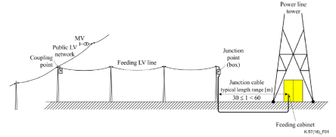
Aspects to which attention should be given (2)
Power supply and protecton:
Feeding from LV network
Isolating transformer – to separate earth potential rise area from the surrounding
Appropriate isolation level of the primary winding with regards to the secondary winding, the iron core and any other metallic part of the cabinet
Isolation of the LV junction cable with regards to any earthed part of the cabinet and tower, and to the earth in the zone of earth potential rise
Appropriate selection of surge protective devices (SPD)
Feeding from MW network
MV/LV transformer – as isolation to separate earth potential rise area from the surrounding

Slide 5
Aspects to which attention should be given (3)
Lightning protection system:
The assessment of the need for the lightning protection system and the determination of its positioning must be performed with the rolling sphere method:
Antennas are installed above the earth wires
Antennas are installed above the phase conductors at a greater distance from the axis of the tower
Antennas are installed below the upper phase conductor and protrude from the axis of the tower more than phase conductor
In the case where the antenna is located below the phase conductors the expected induced overvoltage usually does not exceed the withstand voltage level of the insulation of the coaxial cable.
Induced overvoltage can achieve the withstand voltage level of insulation or can even exceed it, if the antenna is mounted above the phase conductors.

Slide 6
Requirements for equipment installation and maintenance
Technical possibilities for equipment installation
LV network operator requirements - to protect LV network
Requirements of the owner of the tower - regarding the approach of setting and maintenance the equipment
Installation and maintenance of the equipment on the tower can only be performed by personnel trained to work in electric and magnetic fields

Slide 7
Conclusion
Prior to installing the radio base station on power line tower it is required to explore:
the earth potential rise at the location and in the surrounding
induced voltage, which can appear in the event of earth fault at the tower or lightning strike at the tower or transmission line
It is necessary to carry out the proper earthing system for an effective equalization of potential differences at the location.
Radio base station feeding must be carried out so that consumers and the equipment are not threatened due to earth potential rise because of earth faults or lightning strikes.

