Slide 1
Water hammer control strategies of Kaplan turbine hydropower plants in Slovenia
Jernej Mazij & Anton Bergant
5. Savjetovanje CG KO CIGRE, 9 - 12.5. 2017, Bečići, Montenegro
Notes:
Mr. Speaker, thank you for the introduction
Dear participants,
My presentation will be about water hammer control stretegies of Kaplan turbine hydropower plants in Slovenia.
Gospodine predsedavajući, hvala za uvođenje Poštovani učesnici, Moja prezentacija će biti oko kontrole tranzijenta kot Kaplan turbinama u hidroelektrane u Sloveniji.

Slide 2
Contents:
Introduction
Hydraulic transients
Case study: Zlatoličje, Krško and Plave II HPP
Conclusions
Notes:
The content of my presentation will be:
1. Short introduction of the situation in Slovenia regarding the location and status of HPP development.
2. Hydraulic transients and specific issues
3. Case studies
4. Conclusions.
Sadržaj mog izlaganja će biti: 1. Kratak uvod o situaciji u Sloveniji u vezi lokacije i stanja razvoja HE. 2. Hidraulične tranzijenti i specifična pitanja 3. Studije slučaja 4. Zaključci.

Slide 3
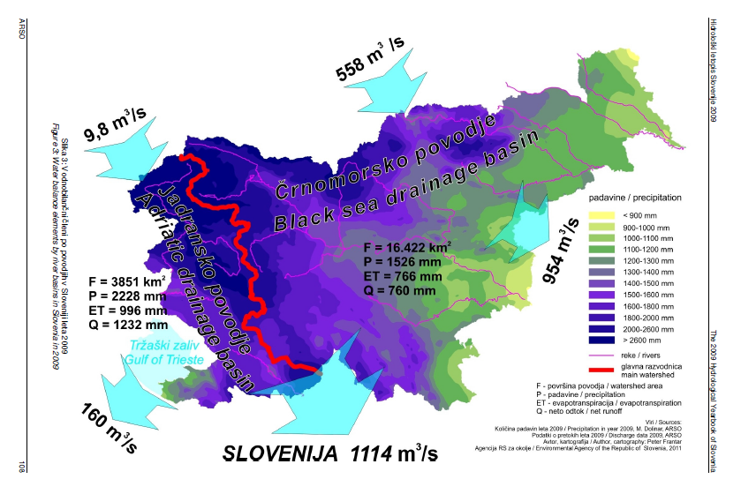
1.1 Introduction – Drainage basins
Notes:
1.1 Introduction – Drainage basins
Let us first see the geographical layout of the 2 mayor river drainage basins in Slovenija; Adriatic and Black Sea drainage basin.
The numbers for discharge are from 2009, it gives the broad idea of the values. The mayor inflow coming from Austria through the Drava river
We can see that the mayority of the precipitation is located in the north-west of the country.
1.1 Uvod – Vododelnice
Ovdje vidimo geografski raspored na 2 glavne vododelnice u Sloveniji; Jadransko i Crno more. Brojevi za protoke su od 2009. godine, što daje ideju vrednosti. Glavni protok dolazi iz Austrije preko reke Drave. Možemo videti da se većina padavina nalazi u severozapadu zemlje.

Slide 4
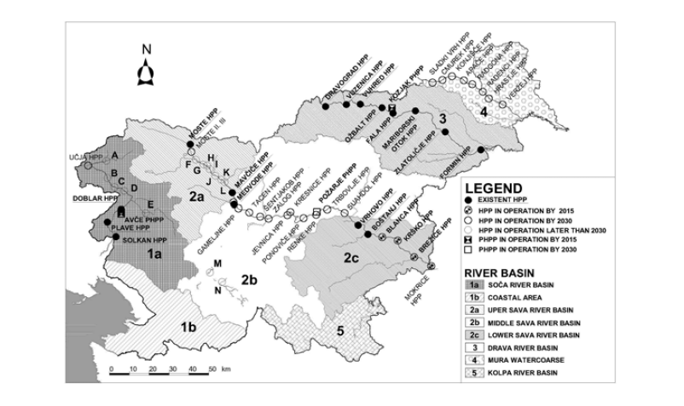
1.2 Slovenia HPP layout
Gross hydropower potential: 19440 GWh/year
Total technically available potential: 9145 GWh/year
Locations with > 0,5 MW: 122
Current explotations: 45 % → 4115 GWh/year
Notes:
1.2 Slovenia HPP layout
From this slide we can see mayor developments of HPP in Slovenija; allready built, on-going and planned. Gross hydro potential is 19440 GWh/year. Current exploitation is 45 % of technically available potential.
Mayor developments are planned on the Sava river basin, while the Soča and Drava river basins are allready fully developed.
A large number of potential locations for HPP with output of > 0,5 MW
1.2 Raspored HE u Sloveniji Iz ovog slajdu možemo da vidimo glavni lokacije HE u Sloveniji; već izgrađene, u radu i planirane. Bruto hidropotencijal je 19440 GVh / god. Trenutna eksploatacija je 45% tehničkog raspoloživog potencijala. Trenutno so glavni radovi na reki Save, dok su Soča i Drava več so u potpunosti razvijen. Veliki broj potencijalnih lokacija za HE sa snagom na> 0,5 MV

Slide 5
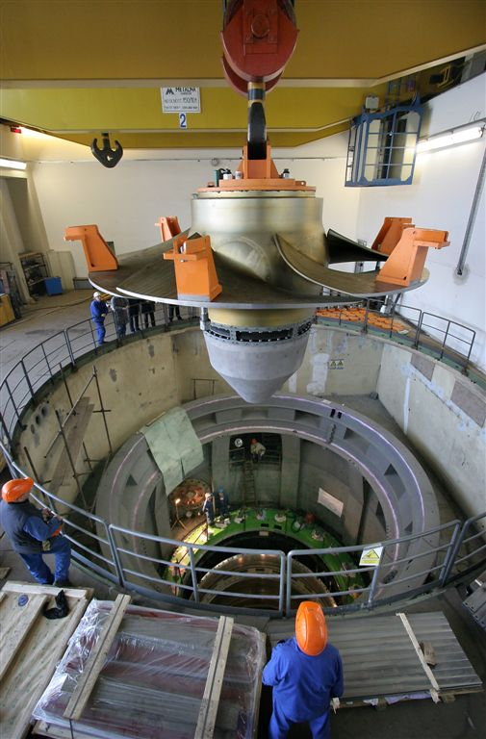
2.1 Kaplan turbines – specific issues
Short inlet/outlet conduits and rigid water hammer theory
Water column separation
Axial hydraulic thrust measurements and calculation
Surge tank installation for low head development
Notes:
2.1 Specific issues relating to Kaplan turbines
General issues regarding hydraulic transients have already been presented in the past. Specific transient issues relating to Kaplan turbines covered in this paper are:
Short inlet and outlet conduits and the corresponding rigid water hammer theory
Water column separation
Axial hydraulic thrust
Surge tank installation for a low head development in case of Plave II HPP
2.1 Posebna pitanja koja se odnose na Kaplan turbine Specifični pitanja koja se odnose na Kaplan turbine ovom radu su: Kratki ulazni i izlazni vodovi i odgovarajući teorija krutog vodnog udara. Odvajanje vodenog stuba. Aksialna hidraulička sila. Instalacije vodostana kot Kaplan turbina.

Slide 6
2.2 Water column separation
Water column separation can occur under the turbine head cover and the drat tube inlet during the closing period of the turbine.
Turbine head cover pressure criterion.
Axial hydraulic thrust criterion; measured model axial hydraulic thrust characteristics are used.
Air valves cannot prevent damaging reverse water hammer!
Notes:
2.2 Water column separation
Occurrence of the water column separation under the turbine head cover can be indicated by comparison of the maximum calculated axial hydraulic thrust acting upwards with the damaging hydraulic thrust acting on the runner. – first equation
Turbine head cover pressure criterion; the pressure under the turbine is calculated using measured axial hydraulic thrust characteristics. The ccomputed absolute pressure should be larger than the vapor pressure.
The maximum permissible axial hydraulic thrust acting in the negative direction is predicted by the first equation.
Damaging axial hydraulic thrust is calculated by the following equation in which the full water column separation under the turbine head cover is assumed to occur.
2.2 Odvajanje vodenog stuba Pojava odvajanja vodenog stuba ispod poklopca glave turbine može biti prikazana upoređivanjem maksimalne izračunane aksialne hidraulične sile koja radi nagore sa štetno aksialno hidraulično silo koja radi na radno kolo. - Prvi jednačina Kriterijum pritiska izpod turbinskog poklopca; pritisak ispod turbine izračunava pomoću izmerene aksijalnog hidrauličke karakteristike sile. Obračunat apsolutni pritisak treba da bude veći od pritiska pare. Maksimalno dozvoljena aksijalna hidraulična sila deluje u negativnom smeru predviđa je sa prvo jednačino Oštećenja aksijalna hidraulična sila je obračunana uz pomoću sledeće jednačine u kojoj predviđeno je puno odvajanje vodenog stuba ispod poklopca turbine glave.

Slide 7
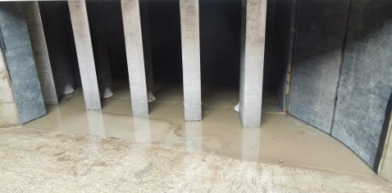
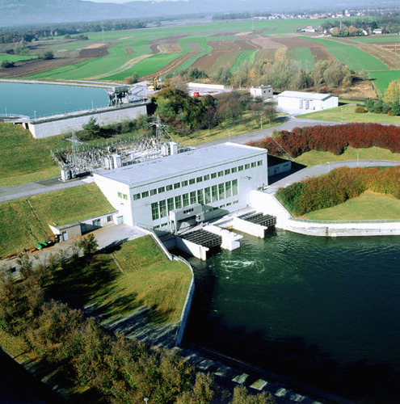
3.1 Case study: Zlatoličje HPP - Overwiev
Inflow Channel
Turbine
PRV
Drava river basin: 8 stations + potential for turbine/pump projects
Channel type and largest in Slovenia (160 MW capacity).
Long inflow (17,200 m) and outflow (6,200 m) open channels.
Special pressure regulating valve controls unsteady flow.
Located at the outlet side of the flow-passage.
Notes:
3.1 Case study 1: Zlatoličje HPP - Overwiev
Here we present the first case study of Zlatoličje HPP.
Located on the Drava river basin; fully developed with 8 stations and potential for pump turbine projects.
Largest HPP in Slovenia with 160 MW capacity.
Special pressure regulating device controls unsteady flow.
3.1 Studija slučaja 1: Zlatoličje HE - Pregled Ovde ćemo predstaviti prvu studiju: Zlatoličje HE. Nalazi se na reki Dravi; u potpunosti razvijen hidropotencial sa 8 stanica i potencijal za reverzibilne (pump, turbine) projekte. Najveći HE u Sloveniji sa 160 MV snage Smešten na izlaznoj strani protoka.

Slide 8
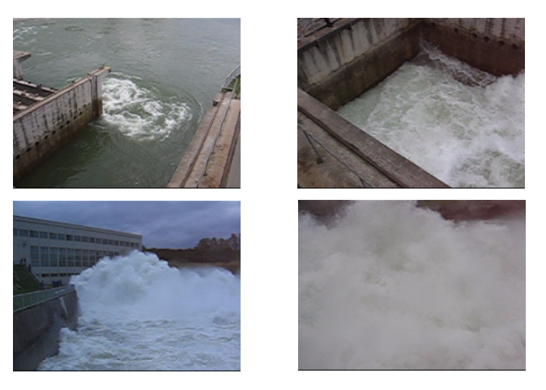
3.2 Case study: Zlatoličje HPP - PRV in operation
Notes:
3.2 Case study 1: Zlatoličje HPP – PRV in operation
Start of the operation
Upside view
Down side view
Violent operation
3.2 Studija slučaja 1: Zlatoličje HE - PRV u radu Početak operacije Naopako pogled Dolni pogled Rad kot velike snage

Slide 9
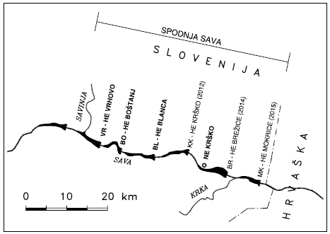
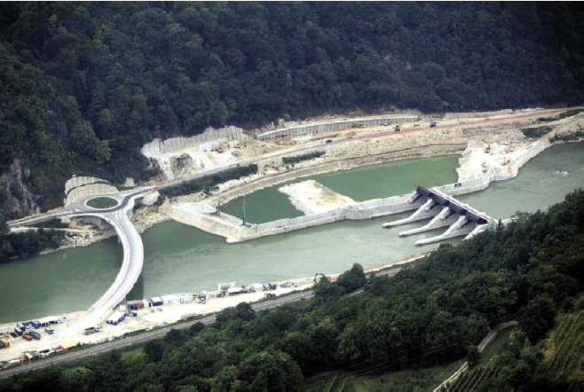
3.3 Case study: Krško HPP - Overwiev
Sava river basin: the largest but only 13 % utilized.
Unifined design of the power house for Blanca, Krško and Brežice.
Additional civil engineering works.
Fully automated and unmanned operation.
Location of NPP Krško downstream presents additional challenges
Notes:
3.3 Case study 2: Krško HPP - Overwiev
Located on the lower Sava river basin; it is the largest but the least utilized.
In order to save cost, the unified design of the power house HPP Blanca, Krško and Brežice was used.
Additional civil engineering works had to be done; bridges, roads and landslide control.
Fully automated and unmeaned operation is expected.
Location of the nuclear power plant Krško presentd additional challenges in construction due to limitations of the tail water level fluctuations.
3.3 Studija slučaja 2: Brežice HE - Pregled Nalazi se na donjem delu reke Save; to je najveća, ali je najmanje iskorišćena. U cilju uštede troškova, korišćen je ujedinjen dizajn snage kuće HE Blanca, Krško i Brežice. Dodatni građevinski radovi morali da se uradi; mostovi, putevi i kontrolu klizište. Potpuno automatizovan rad. Lokacija nuklearne elektrane Brežice predstavlja dodatne izazove u izgradnji zbog ograničenja kretanja nivoa gornje vode.

Slide 10
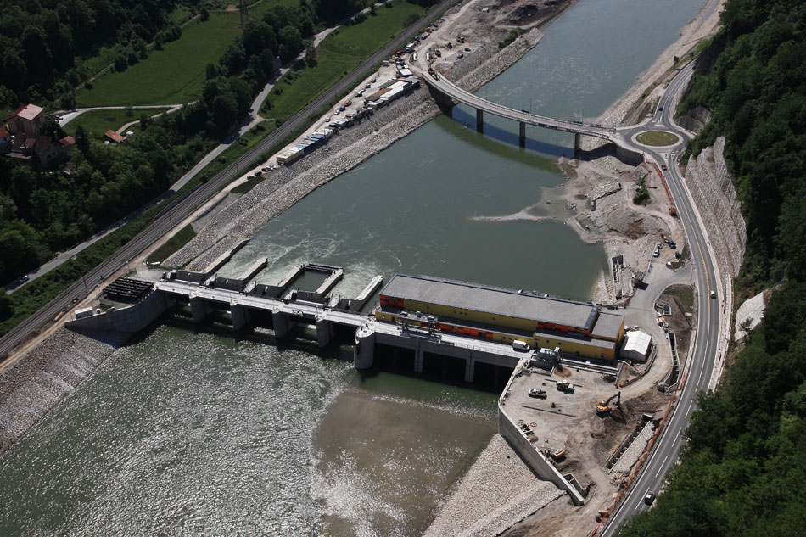
3.4 Case study: Krško HPP – Unified design
Errection plateau
Dam section
Powerhouse section
Notes:
3.4 Case study 2: Krško HPP – Unified design
On this slide we see general (unified) desing of the HPP Krško. The same design is also used for 2 others HPP
Dam section on the left side with 5 gates (over flow) section, powerhouse section with 3 Kaplan units and errection plateau.
This type of design saves cost and time; in civil and engineering works.
3.4 Studija slučaja 2: Brežice HE - Ujedinjen dizajn Ujedinjen dizajn od HE Krško. Isti dizajn je takođe koristi se za 2 drugi HE Brana na levoj strani sa 5 zapornicama. Strojarna sa 3 Kaplan jedinicama. Ova vrsta dizajna uštedi troškove i vreme; u građevinskih i strojarskimi radova.

Slide 11
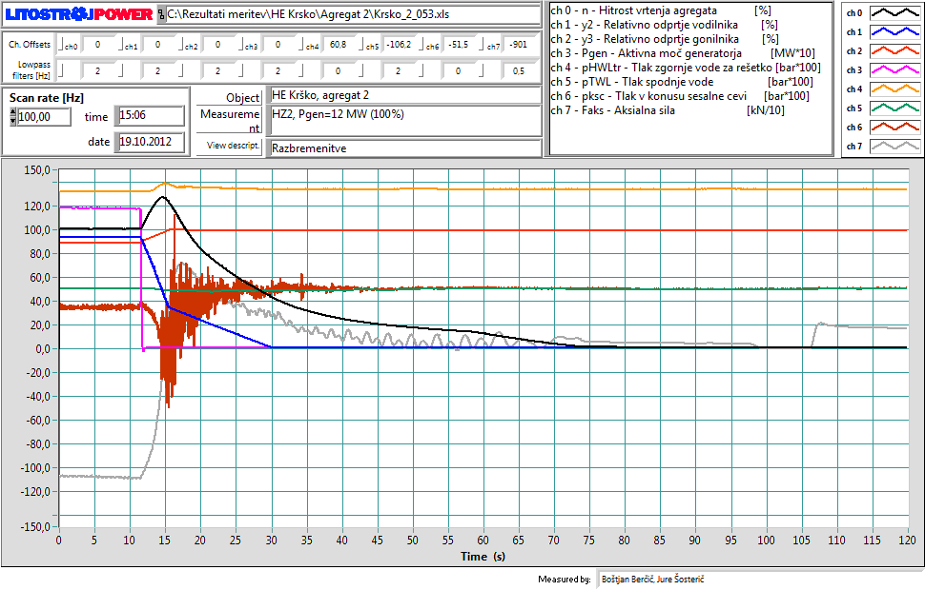
3.5 Case study: Krško HPP – Transient operation
Notes:
3.5 Case study 2: Krško HPP – Transient operation
Here we see a general record of a transient operation during emergency shut down.
Closing of the guide vanes and opening of the runner blades.
Rise of the rotational speed rise, pressure in the spiral case.
Change of the axial hydraulic thrust can be seen. Force acting downward is negative.
Comparison of the measured and calculated results are presented in the paper.
3.5 Studija slučaja 2: Brežice HE – Tranzijentni rad
Ovde vidimo generalni zapis tranzijentnog rada tokom izvanrednog ustavljanja hidroelektrarne. Zatvaranje vodeće lopatice i otvaranje lopatica radnog kola. Porast brzine vrtnje i pritiska u spirali. Promena aksijalne hidraulične sile potiska može da se vidi. Sila koja radi na dole je negativna. Poređenje izmerenih i izračunatih rezultata su prikazani u radu.

Slide 12
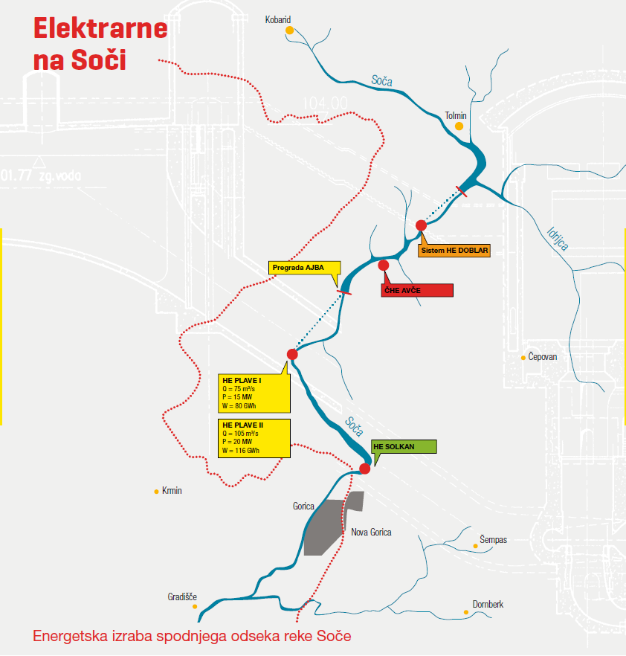
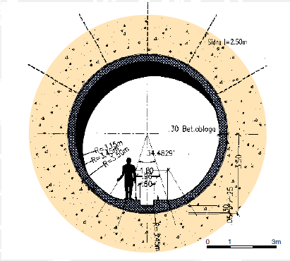
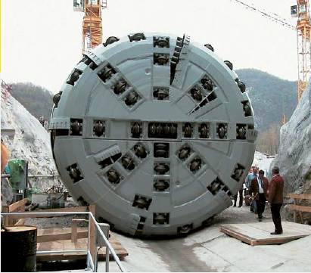
3.6 Case study: Plave II HPP– Overwiev
Notes:
3.6 Case study: Plave II – Overwiev
Development of the Soča river basin started during WW1 & 2. Desing of the Plave II was based on the available potential and infrastructure of the existing Plave I.
Tunnel construction using TBM method for the first and only time in Slovenia.
Additional construction of a surge tank.
3.6 Studija slučaja: Plavo III - Pregled Razvoj hidropotenciala na reki Soči počelo se tokom VV1 i 2. Dizajn na Plave II je osnovan na dostupnom potencijalu i infrastrukture postojeće HE Plave I. Tunela izgrađen je sa metodom TBM. To je prvi i jedini put u Sloveniji. Izgrađen je i vodni stolp.

Slide 13
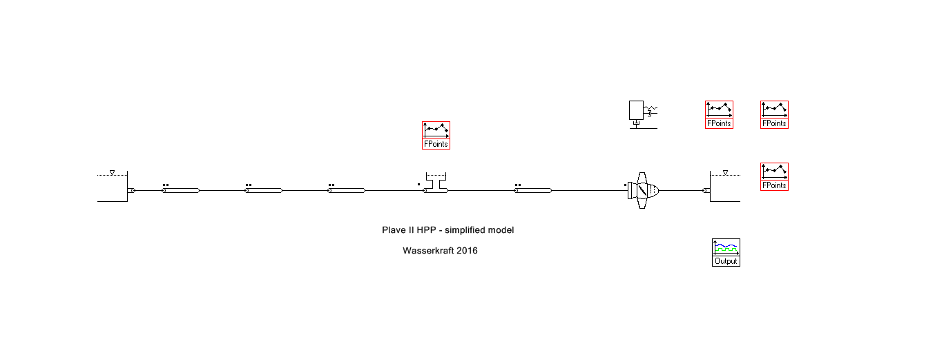
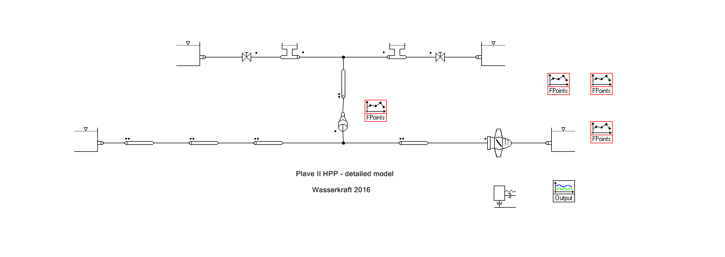
3.7 Case study: Plave II HPP– Modelling
Two models: simplified or detailed using SIMSEN commercial software.
Inertia of the water in the connecting pipe has an influence on the pressure.
Maximuim surge tank water level is achieved.
Notes:
3.7 Case study: Plave II – Modelling
On this slide we see to approaches for flow-passage modelling; the upper is the simplified one with the two surge tanks modelled as one.
The lower is a more detailed one with two surge tanks and a connecting pipe.
Specifics of the detailed model are the two surge tanks; valve with a headwater level. Specific procedure for SIMSEN.
3.7 Studija slučaja: Plavo III - Modeliranje Ovdje vidimo dva pristupa za modeliranje; gornja je pojednostavljena onaj sa vodostana modelirana kao jedno. Niži je detaljniji sa dva vodostana i povezovalnom cevovodu.

Slide 14
4. Conclusions
Transient analysis for Kaplan HPP schemes is (in general) less complicated (easier) than Francis HPP schemes.
Main issues: speed rise, axial hydraulic thrust and pressure in the spiral case.
Conditions for high head HPP schemes are not favorable in Slovenia.
Litostroj Power has the knowledge and the experience for a thorough transient analysis of a Kaplan turbine.
Thank you for your attention!
Notes:
4. Conclusions
Zaključci Prolazni analiza Kaplan HE šeme je (u generalu) manje komplikovano (lakše) nego Francis HE sheme. Glavna pitanja: brzina rise, aksialna hidraulična sila i pritiska u spirali. Uslovi za HE sheme sa visokimi padovi nisu povoljni u Sloveniji. Litostroj Pover ima znanje i iskustvo za temeljnu transient analizu Kaplan turbine.

